Slide 1
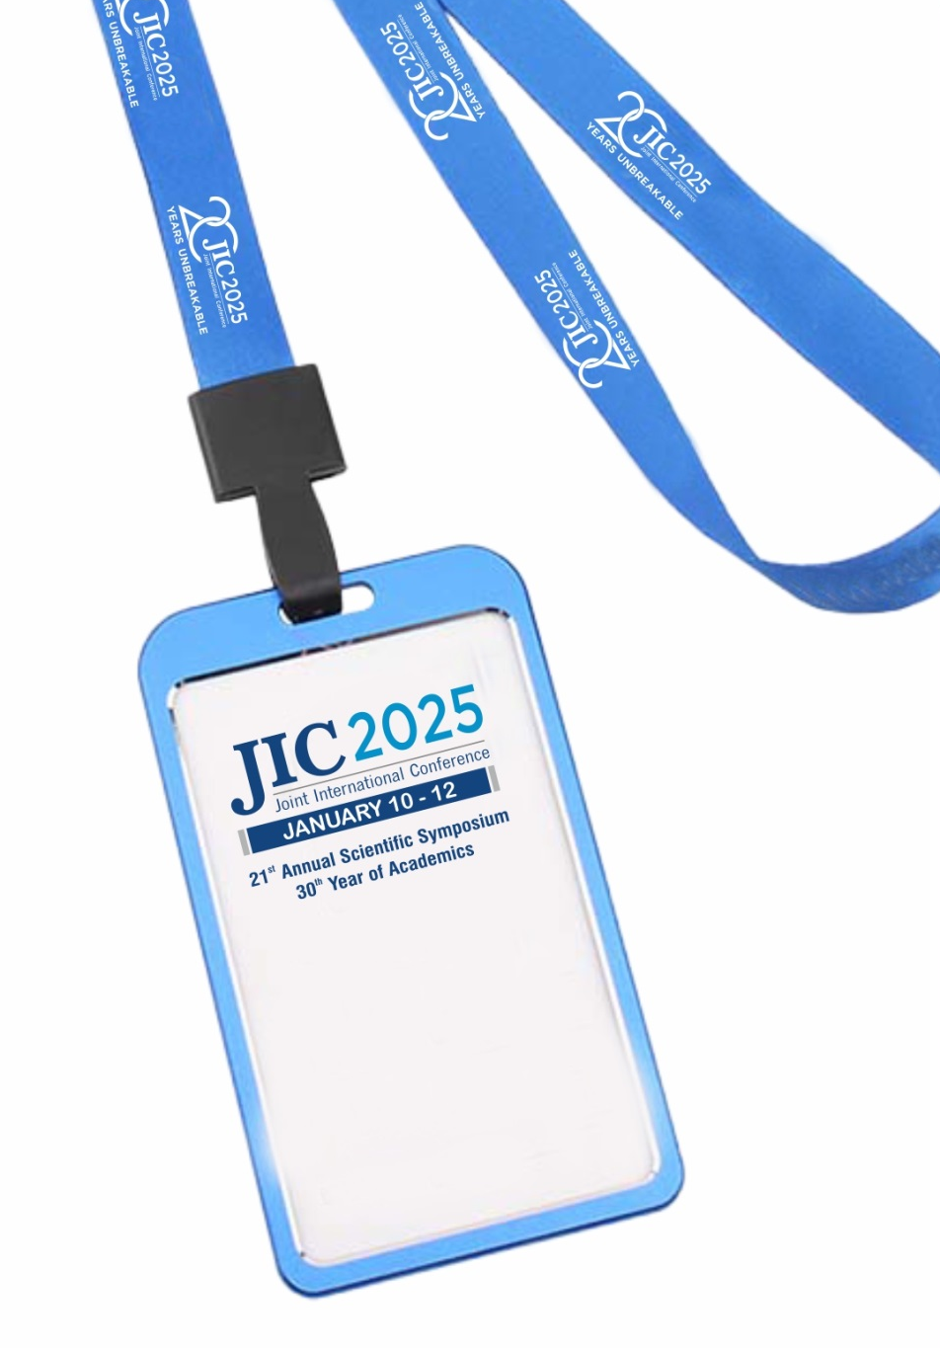
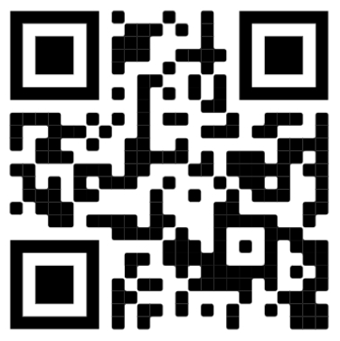
CONFERENCE BADGE
IS YOUR ENTRY PASS
TO ALL VENUES.

Slide 2
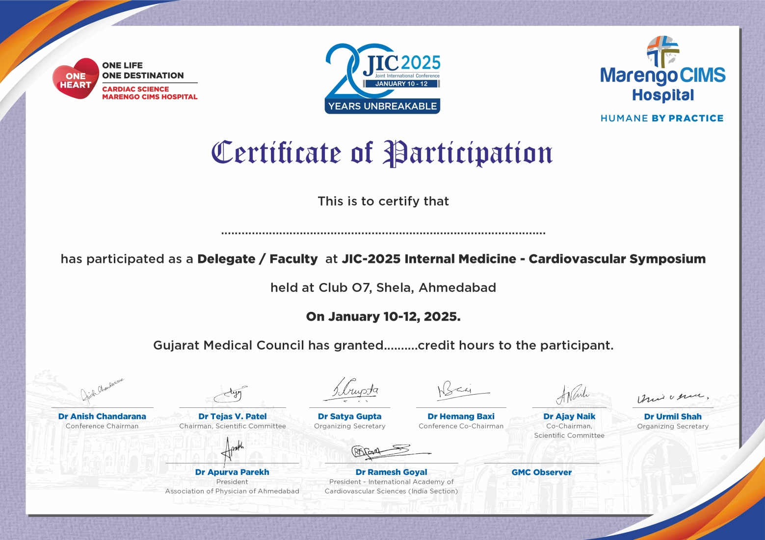
Please sign (In & Out) attendance sheet before entering the lecture hall, to avail MCI Credit Hours Certificate.

Slide 3


Slide 4
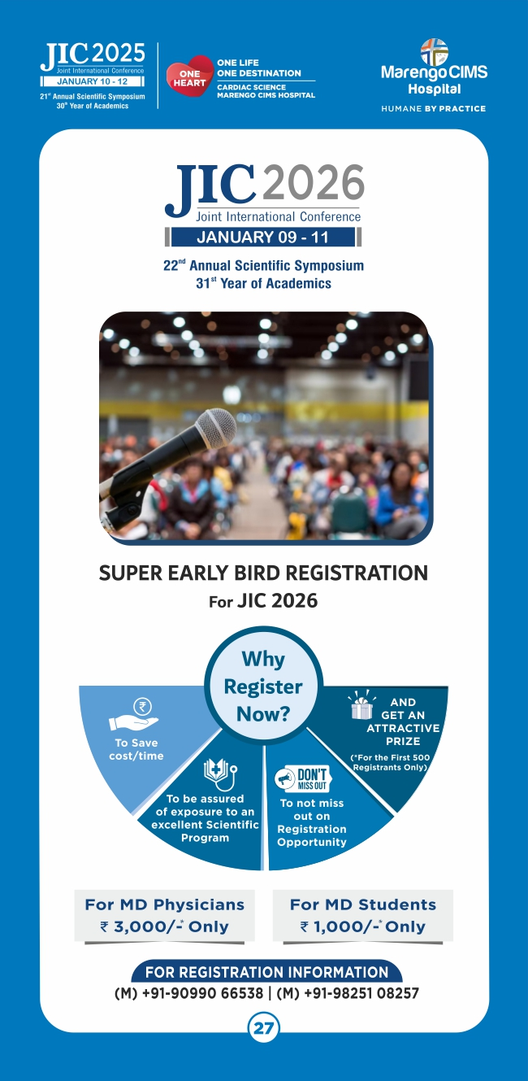

Slide 5

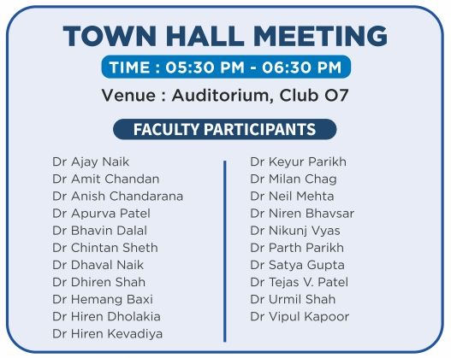

Slide 6
SATELLITE SESSIONS
January 10, 2025
(Time: 07:00 PM – 09:00 PM)
An Evening of Cardiac Pharmacology & Therapeutics
Emergency Symposium
Nephrology Symposium
Neurology Symposium

Slide 7



Slide 8

MOTIVATE THE STUDENTS
Please Attend
Poster Presentations
January 10 - 11, 2025

Slide 10

CARDIOVASCULAR SYMPOSIUM
JANUARY 11, 2025, TIME : 08:30 AM – 04:30 PM
Venue:
Auditorium, Club O7

Slide 11
IACS Sessions & Orations
JANUARY 11, 2025, TIME : 08:30 AM – 04:30 PM
Venue:
Confluence - 3 –Club O7

Slide 12
SATELLITE SESSIONS
January 11, 2025
(Time: 07:00 PM – 09:00 PM)
Pulmonary Critical Care Symposium
Infectious Disease Symposium
Nephrology Symposium

Slide 13

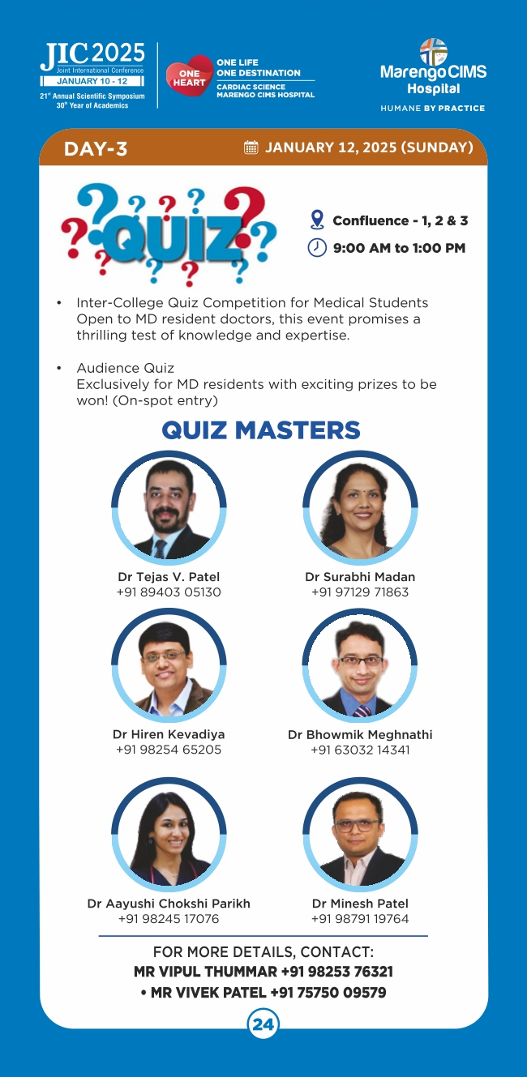

Slide 14
CARDIOVASCULAR SYMPOSIUM
JANUARY 12, 2025, TIME : 07:30 AM – 01:30 PM
Venue:
Auditorium, Club O7

