Slide 1
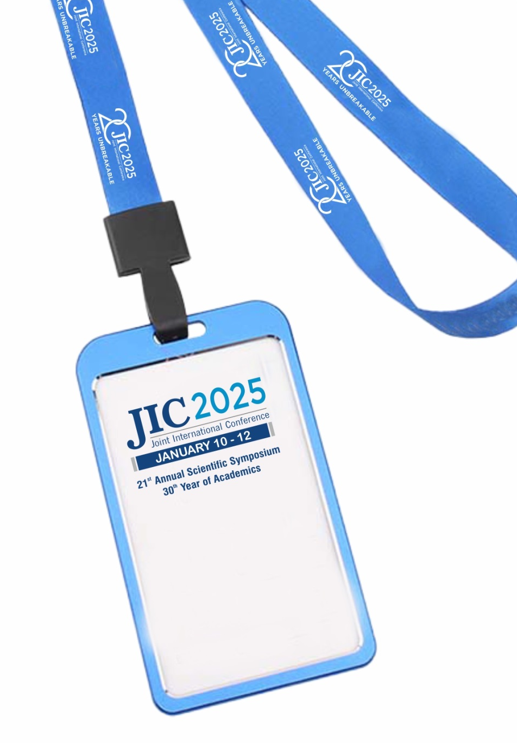
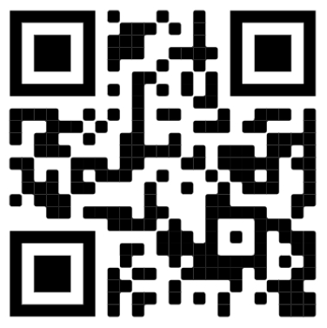
CONFERENCE BADGE
IS YOUR ENTRY PASS
TO ALL VENUES.

Slide 2


Slide 3
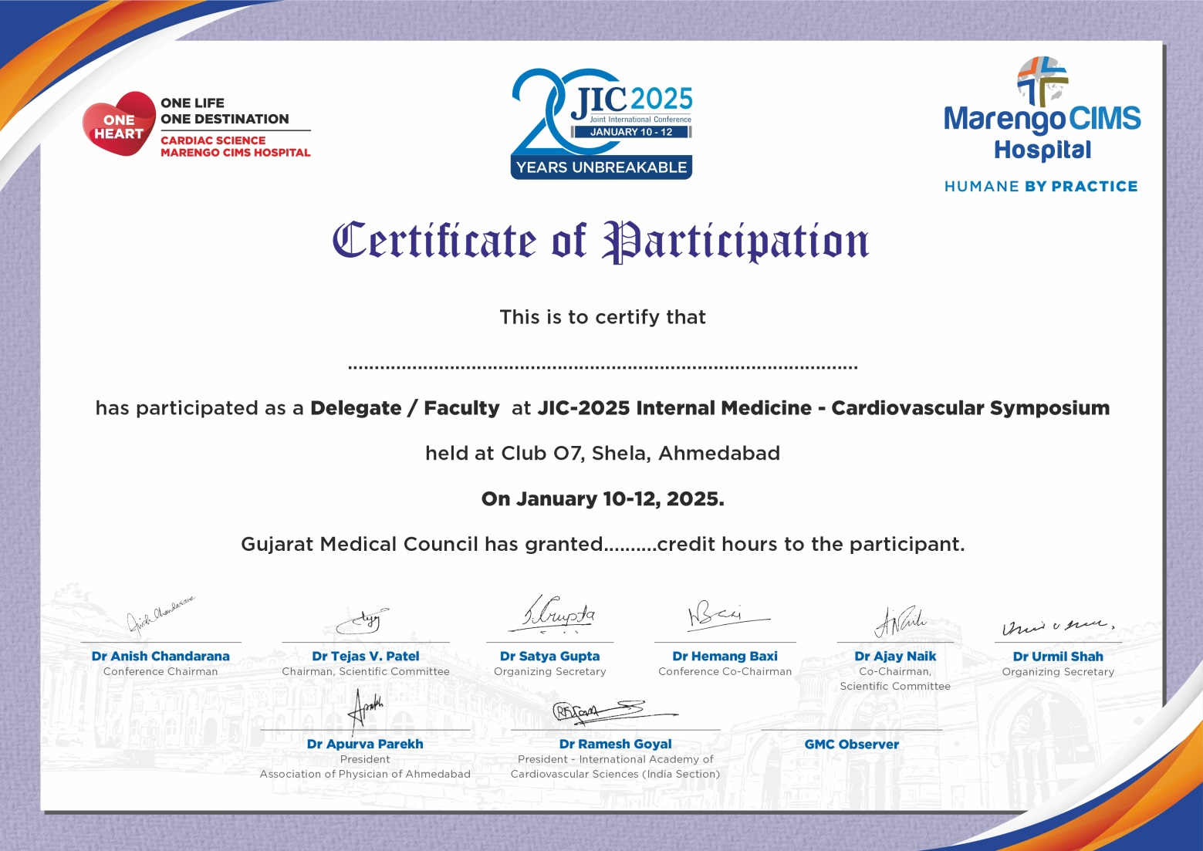
Please sign (In & Out) attendance sheet before entering the lecture hall, to avail MCI Credit Hours Certificate.

Slide 4

CARDIOVASCULAR SYMPOSIUM
JANUARY 12, 2025, TIME : 07:30 AM – 01:30 PM
Venue:
Auditorium, Club O7

Slide 5
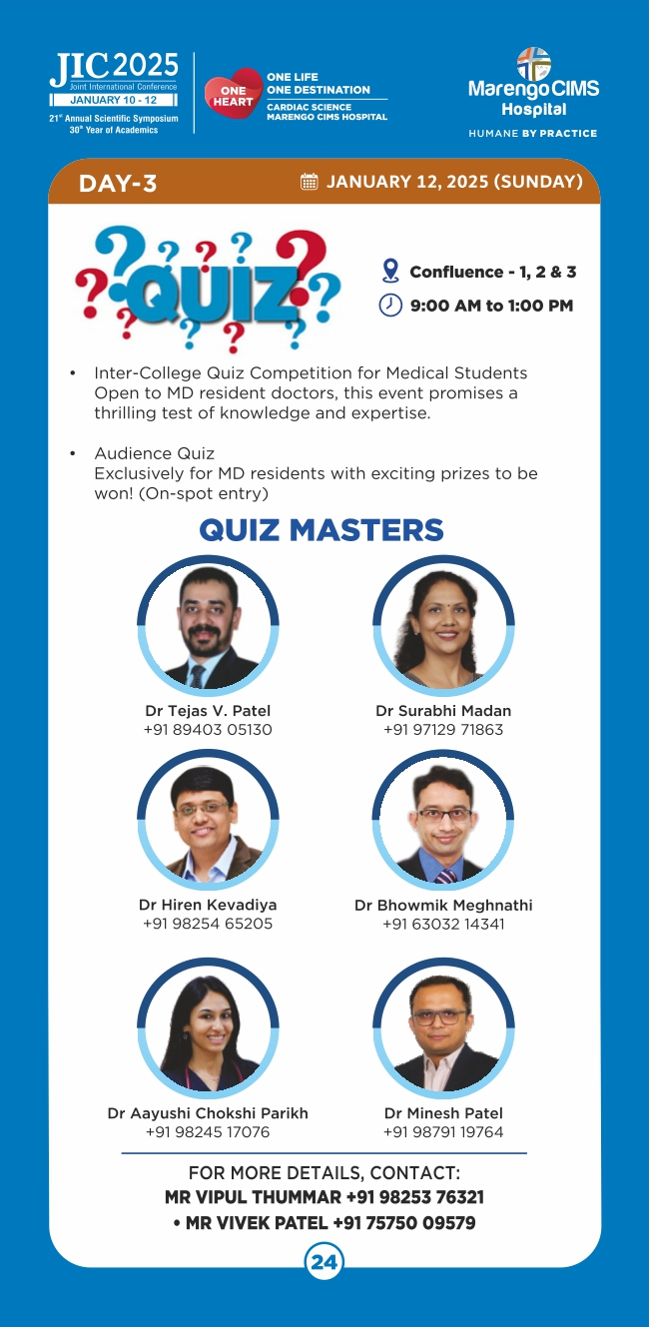

Slide 6
